Slide 1





LET'S EXPLORE THE WORLD!
Presented by: Ginyard International Co.

Slide 2



TOPIC OUTLINE
INTRODUCTION
FLIGHT & HOTEL
ITINERARY
TRIP ESSENTIALS
CONTACT US

Slide 3




INTRODUCTION

Slide 4

INTRODUCTION
We are committed to providing high-quality travel services around the world.
Add a personal touch to this travel presentation by customizing this layout as much as you want. You may add images for added visuals.

Slide 5


ABOUT US
We make sure that your vacation is hassle-free and enjoyable.
Add a personal touch to this travel presentation by customizing this layout as much as you want. You may add images for added visuals.

Slide 6

FLIGHT & HOTEL

Slide 7




FLIGHT
Add the flight details here.
Add the flight details here.
Add the flight details here.

Slide 8





HOTEL
Add the name of the hotel here.
Add the name of the hotel here.
Add the name of the hotel here.
Add the name of the hotel here.

Slide 9

THE ITINERARY & TRIP ESSENTIALS

Slide 10




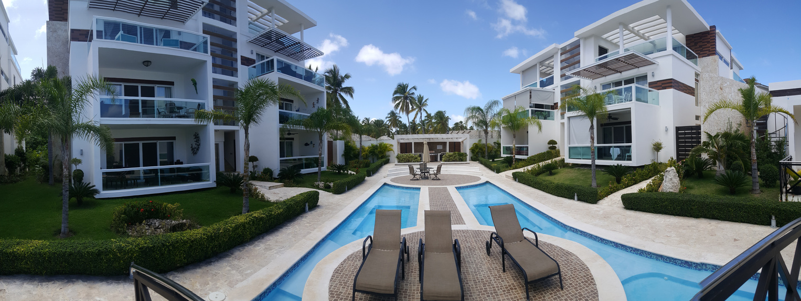
THE ITINERARY
Destination 1
Destination 4
Destination 2
Destination 3

Slide 11









TRIP ESSENTIALS
Passport
Camera
Headphones
Tickets
Luggage
Clothes
Phone

Slide 12







BOOK YOUR NEXT VACATION WITH US!
123-456-7890
CONTACT US
HELLO@REALLYGREATSITE.COM
@REALLYGREATSITE
WWW.REALLYGREATSITE.COM
123 ANYWHERE ST., ANY CITY

Slide 13










FREE RESOURCE PAGE

Slide 14









FREE RESOURCE PAGE

